Slide 1
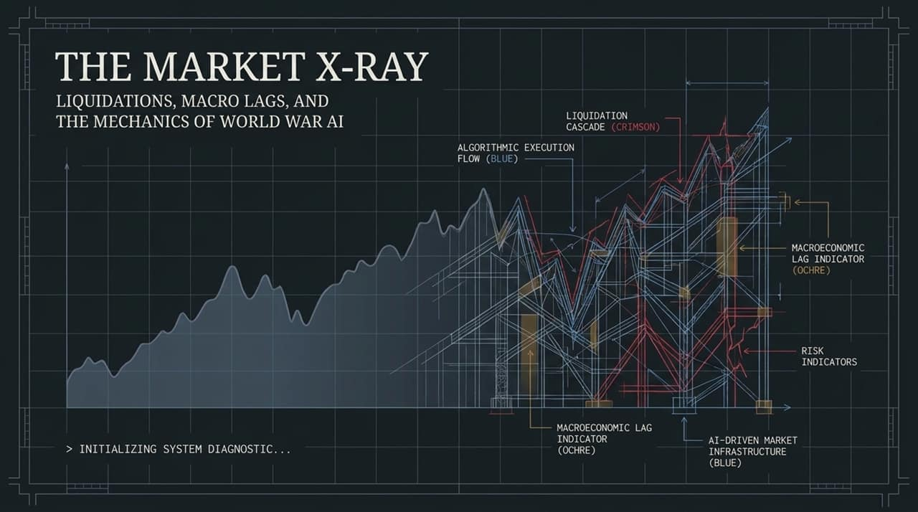
Notes:
https://www.youtube.com/watch?v=ojQGZm5PJbA
Setting the Scene:
Welcome everyone. Today, we are taking an "X-Ray" diagnostic view into the hidden structural mechanics driving today’s market.
At a high-level, broad indices like the S&P 500 appear serene, but behind the scenes, extreme internal dispersion, violent sector rotations, and hidden leverage are causing severe friction.
Core Themes Covered:
The $20 Billion Liquidation: How recent volatility in AI and semiconductor names was driven by forced liquidations and margin calls—not fundamental shifts.
World War AI & Capital Demands: The massive $4–5 trillion AI capex buildout, its strain on private credit, and the looming energy crowding-out effect.
Macro Economic Policy Lags: How contractionary forces (yields, oil, strong dollar) operate on a 13-week lag and are beginning to bite a market priced for perfection.
Systemic Risks & Regulatory Voids: The dangers of operating leverage and regulatory paralysis.

Slide 2
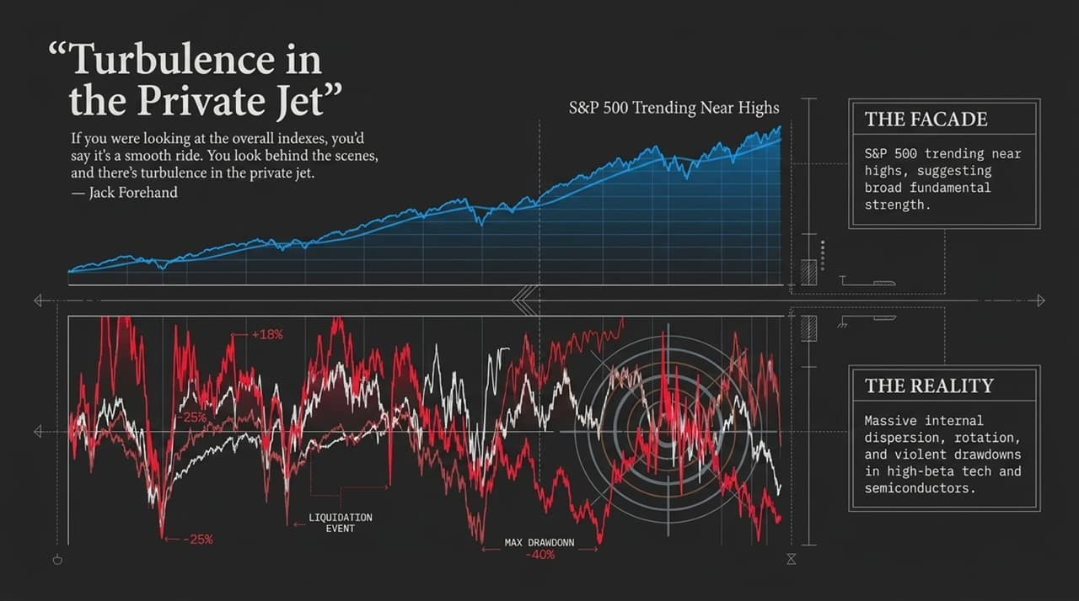
Notes:
The Index Facade vs. Underlying Reality:
To quote Jack Forehand: "If you were looking at the overall indexes, you'd say it's a smooth ride. You look behind the scenes, and there's turbulence in the private jet."
The Facade: Mainstream headline indices show the S&P 500 trending near all-time highs, giving investors a false sense of security and fundamental strength.
The Reality: Under the hood, high-beta tech, AI names, and semiconductors are experiencing drawdowns of 25% to 40%.
Rotation & Volatility:
High-beta technology has taken violent hits. The top portion of the S&P 500 (tech/telecom) has entered correction territory, while older, non-tech sectors have held up or rotated upward.
Because valuation for AI depends heavily on long-term terminal value, any minor model or supply chain news creates massive price shocks.

Slide 3
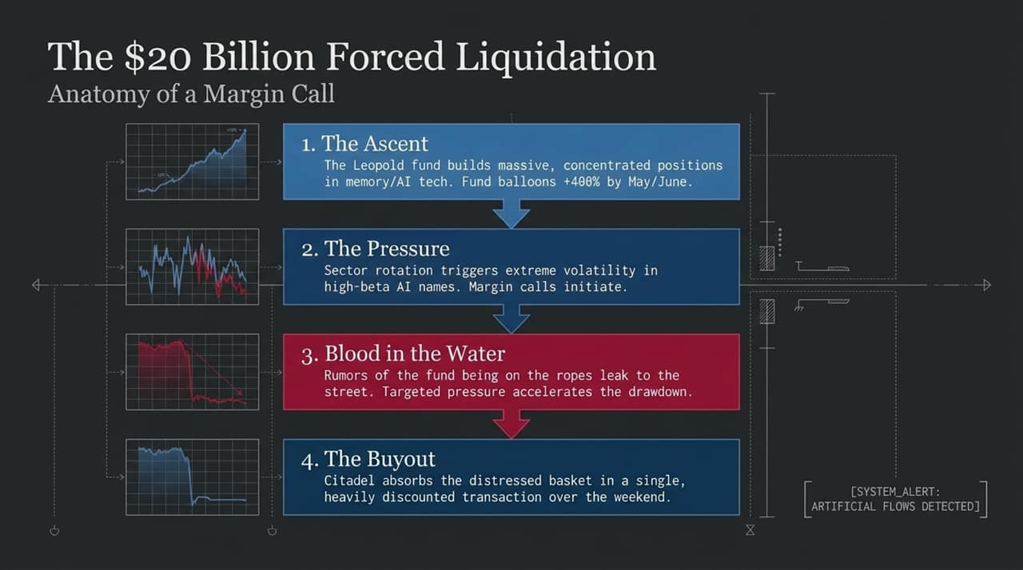
Notes:
The 4-Step Breakdown of the Blowup:
The Ascent: A highly concentrated fund (run by Leopold) built huge bets in memory and AI hardware, surging +400% into May/June.
The Pressure: Sector rotation and memory/semiconductor pullbacks triggered severe margin calls.
Blood in the Water: Word leaked to Wall Street that the fund was on the ropes, leading traders to push these concentrated names lower.
The Buyout: Citadel absorbed the entire distressed basket in a single discounted transaction over the weekend.
Key takeaway:
When price action drops 30–35% in a month due to a single fund's distress, price action is being driven by liquidity mechanics rather than deteriorating long-term fundamentals.

Slide 4
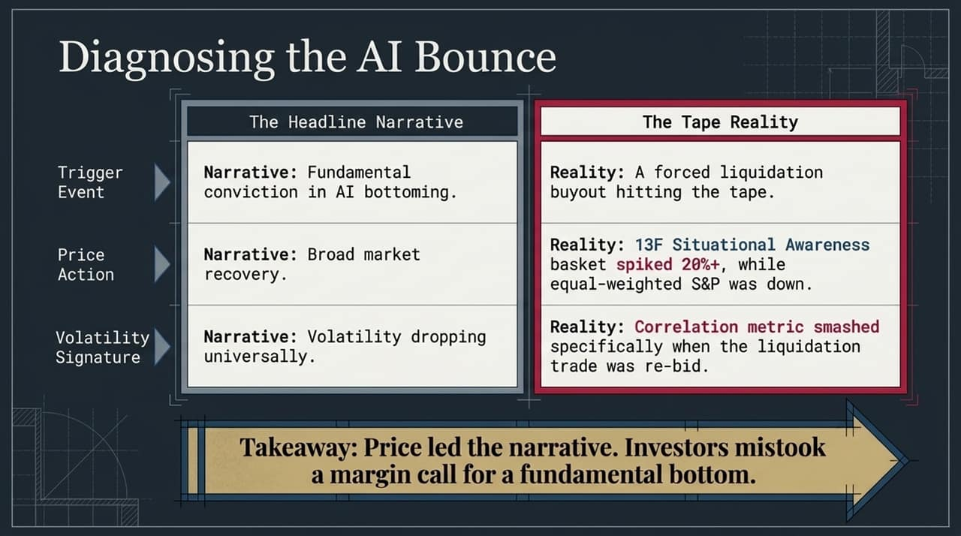
Notes:
Mistaking Liquidation for a Fundamental Bottom:
Trigger Event: Media headlines attributed the 20%+ bounce in memory/semi names to "fundamental AI bottoming". In reality, it was a forced buyout hitting the tape.
Price Action: The 13F basket surged 20% in a single session while equal-weighted indices (RSP) were flat-to-down.
Volatility Signature: Options correlation metrics crashed specifically as this liquidation trade was re-bid, demonstrating that the market misconstrued an artificial order flow for a fundamental shift.
The Lesson:
Investors must look past short-term price reflexivity. Price led the narrative, causing market participants to mistake an unwinding margin call for organic demand.

Slide 5
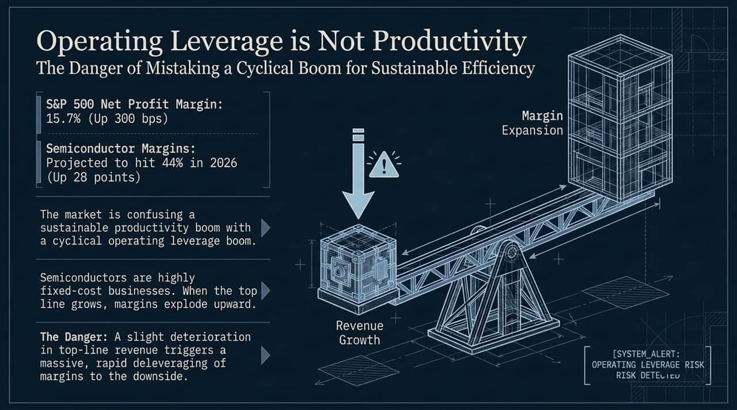
Notes:
Cycle vs. Structural Shift:
Wall Street is celebrating S&P 500 net profit margins of 15.7% (up 300 bps YoY) and semiconductor margins hitting projected records near 44% in 2026.
Analysts are falsely labeling this an "AI Productivity Boom" when it is actually an Operating Leverage Boom.
The Mechanics of Operating Leverage:
Semiconductor manufacturing is a high fixed-cost business. When top-line revenue expands rapidly, margins explode upward.
The Downside Risk: Operating leverage works symmetrically. If top-line revenue growth slows even slightly, high fixed costs will cause profit margins to deleverage rapidly.

Slide 6
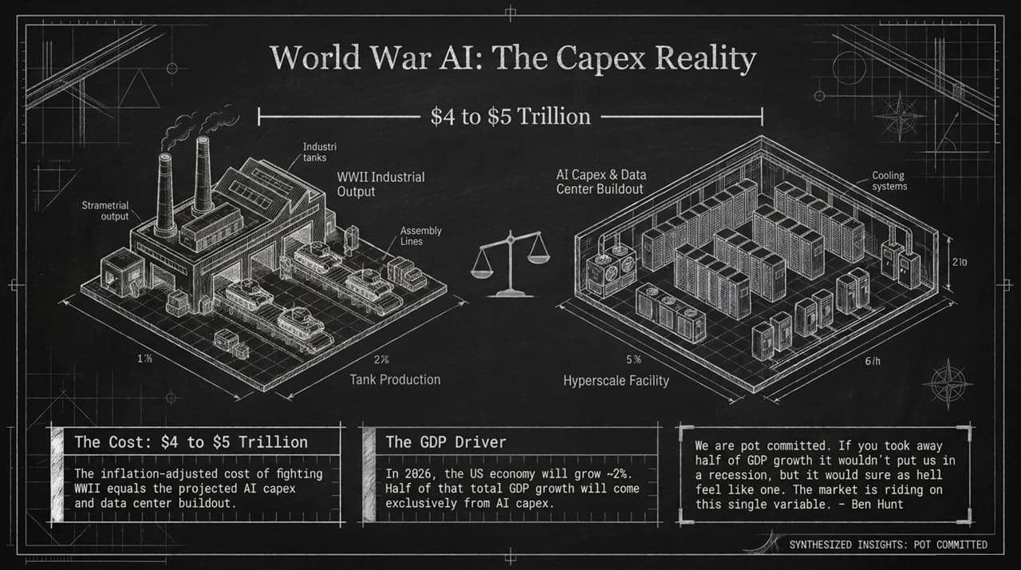
Notes:
Wartime Scale Investment:
Total projected AI capex and data center buildout is estimated at $4 to $5 Trillion. In inflation-adjusted terms, this matches total U.S. expenditure to fight World War II.
Macro GDP Dependence:
In 2026, U.S. GDP growth is projected around 2%. Roughly half (50%) of total U.S. GDP growth is tied directly to AI capital expenditures.
"Pot Committed":
As Ben Hunt notes, both the market and the U.S. government are "pot committed". Removing half of GDP growth would feel like a full-blown recession, forcing policymakers to defend the buildout at all costs.

Slide 7
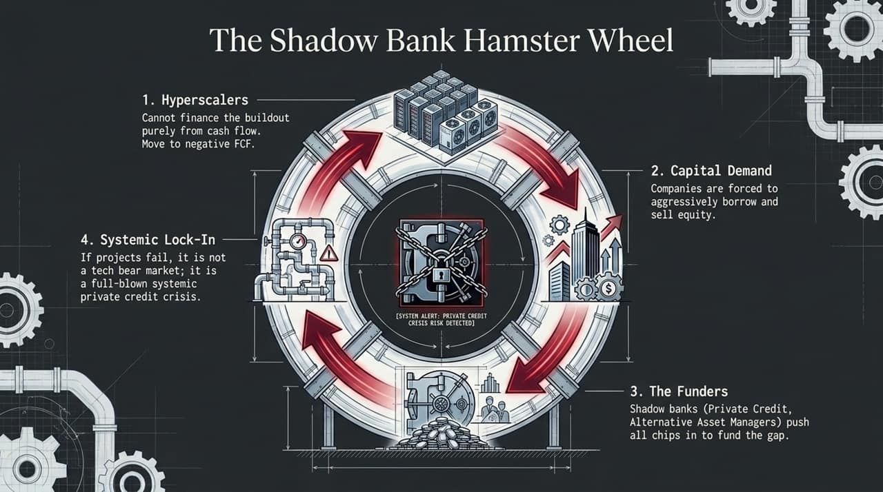
Notes:
Funding Flow Dynamics:
Free Cash Flow Deficits: Major hyperscalers can no longer finance this buildout purely through organic cash flow (e.g., Google moving to negative free cash flow).
Capital Demands: Tech giants must heavily issue debt and sell equity.
The Shadow Banks: Non-bank lenders—private credit, private equity, and alternative asset managers—are funding the bulk of this deficit.
Systemic Risk Transmission:
The risk is not contained in traditional commercial banks, but in private credit markets.
If AI buildout projects fail to generate required returns, the result won't just be a tech bear market—it risks becoming a systemic private credit crisis.

Slide 8
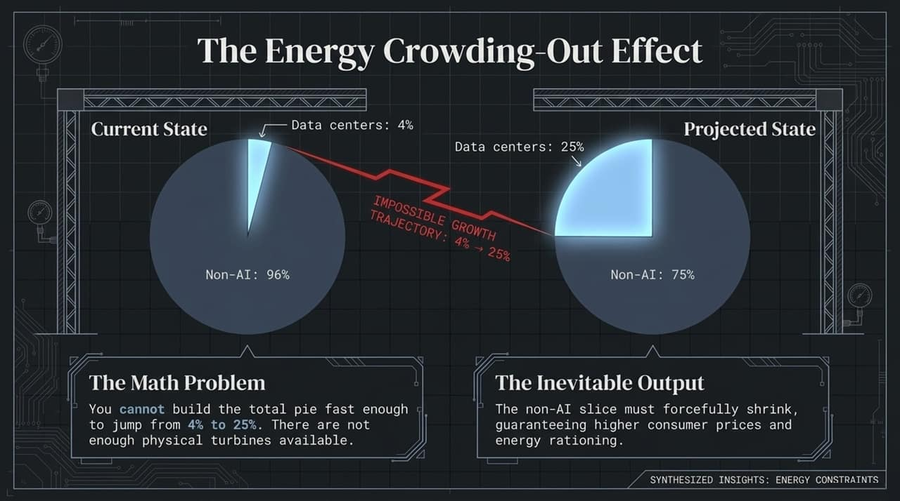
Notes:
The Impossible Growth Trajectory:
U.S. data centers currently consume ~4% of national electricity. Estimates project this will rise to 25% to support planned AI models.
Non-AI power allocation must shrink from 96% down to 75%.
The Math Problem:
It is physically impossible to scale grid generation (turbines, gas plants, infrastructure) fast enough to expand the total energy pie.
Economic Consequences:
As AI consumes a larger slice of power, non-AI consumers will face higher energy prices and potential rationing.

Slide 9
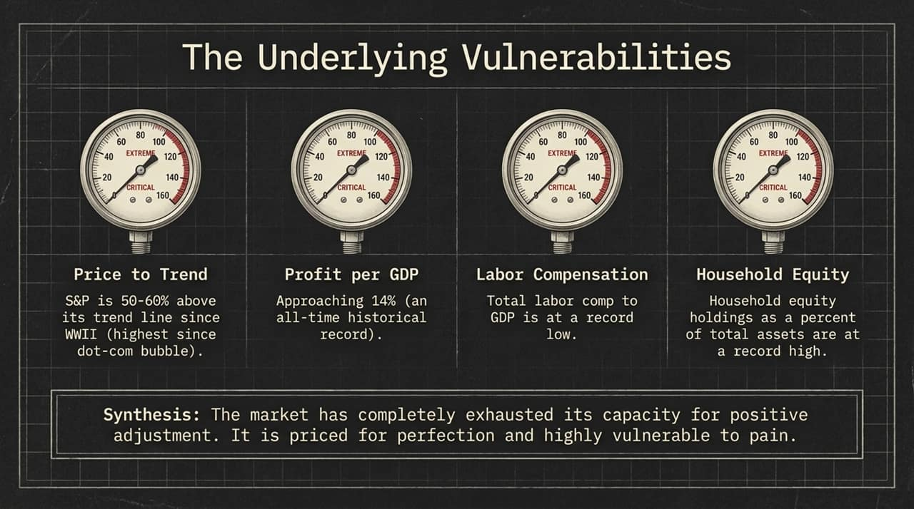
Notes:
Evaluating the Diagnostic Metrics:
Price to Trend: S&P 500 is 50%–60% above its historical post-WWII trend line—the highest elevation since the 2000 Dot-Com bubble.
Profit per GDP: Profits relative to GDP are near 14%, an all-time historical high.
Labor Compensation: Total labor compensation relative to GDP is at a record low, leaving no margin to extract further corporate efficiency.
Household Assets: Household equity exposure is at an all-time high, while cash reserves are near record lows.
Synthesis:
Markets have exhausted their capacity to absorb negative shocks. The system is priced for perfection.

Slide 10
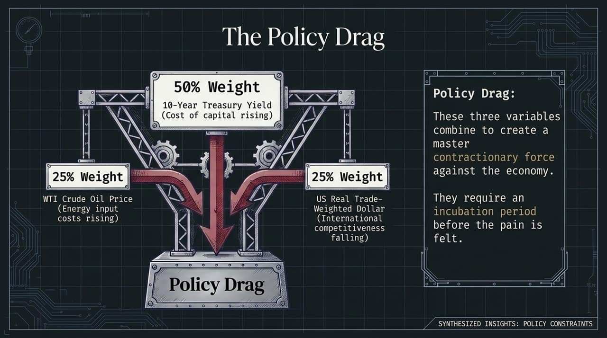
Notes:
The Policy Drag Index:
Combined metric consisting of:
50% Weight: 10-Year Treasury Yield (higher cost of capital).
25% Weight: WTI Crude Oil Price (higher energy input costs).
25% Weight: Real Trade-Weighted U.S. Dollar (reduced international competitiveness).
The Inverted Scale Signal:
These three variables act as a composite restrictive force on the economy.
Tightening forces require an incubation period before their impact shows up in economic data and stock prices.

Slide 11
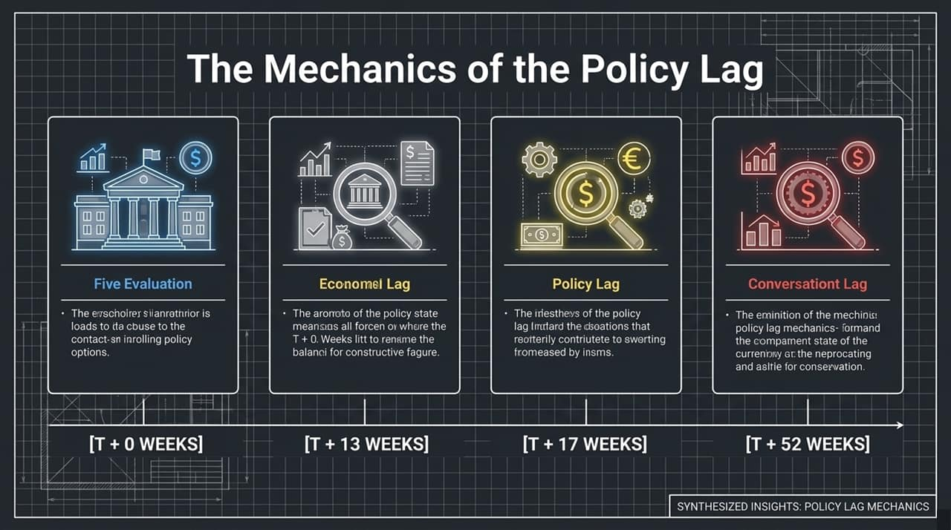
Notes:
Understanding Lag Lead Times:
T+0 Weeks (Policy Change): Rates, oil, or dollar spike. Initial stock market reaction is muted.
T+13 Weeks (Stock Market Lag): Contractionary policy pressure hits equities on roughly a 3-month (13-week) lag.
T+17 Weeks (Bond Market Lag): As economic growth slows, bond yields fall and bond prices rebound roughly 4 weeks after equities begin to struggle.
T+52 Weeks (PMI Economic Lag): Broad economic indicators like manufacturing and service PMIs lag monetary/policy shifts by up to a full year.
Current Position:
The policy tightening from earlier in the year is now hitting its 13-week window, introducing headwinds into current asset prices.

Slide 12
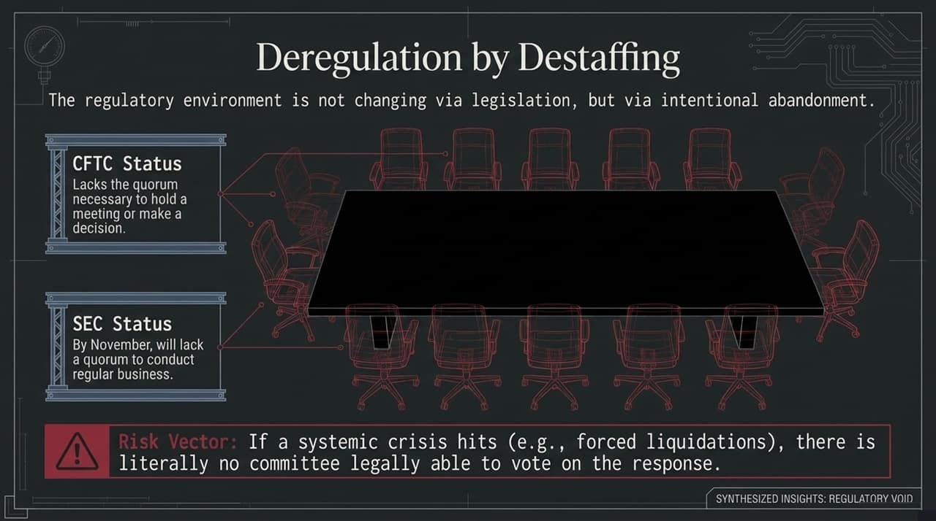
Notes:
De-Facto Inaction:
Deregulation is occurring not through legislation, but by allowing regulatory seats to remain vacant.
Agency Status:
CFTC: Lacks the required quorum of commissioners to hold meetings or make decisions.
SEC: On track to lose quorum and become unable to execute regular enforcement or administrative business.
Systemic Risk Vector:
If a sudden financial shock or forced liquidation cascade occurs, key market regulators lack the legal voting capacity to approve emergency backstops or circuit breakers.

Slide 13
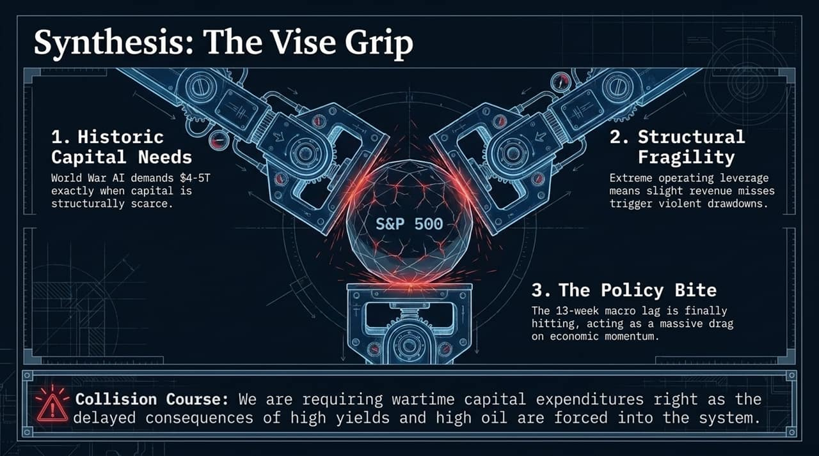
Notes:
Connecting the Core Vectors:
Historic Capital Needs: $4–5T required for AI capex during a period of structural capital scarcity.
Structural Fragility: High operating leverage means minor earnings misses can lead to sharp margin compressions.
The Policy Drag: The 13-week policy lag is catching up with economic momentum.
Closing Quote:
"When people all feel pretty good, like it's a sunny day... that's when the clouds come in from what started to happen three or four months ago." – Jim Paulson

Slide 14
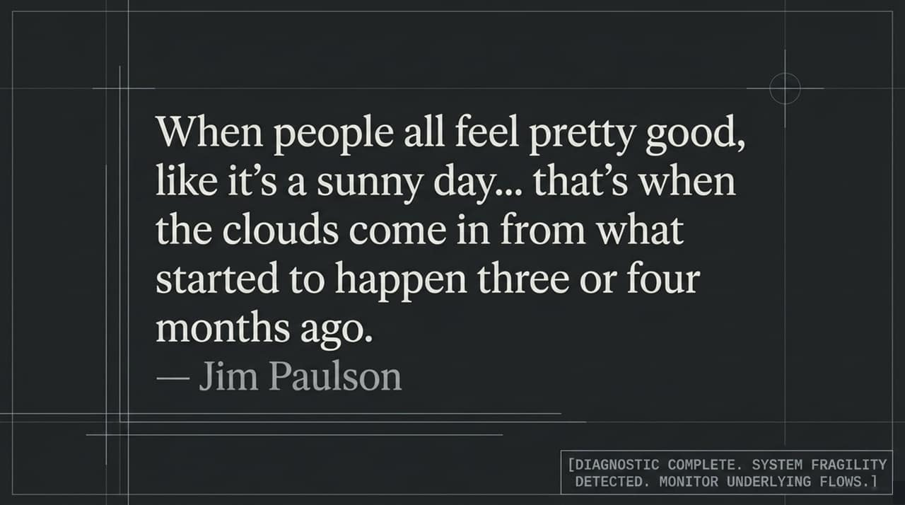

Slide 15
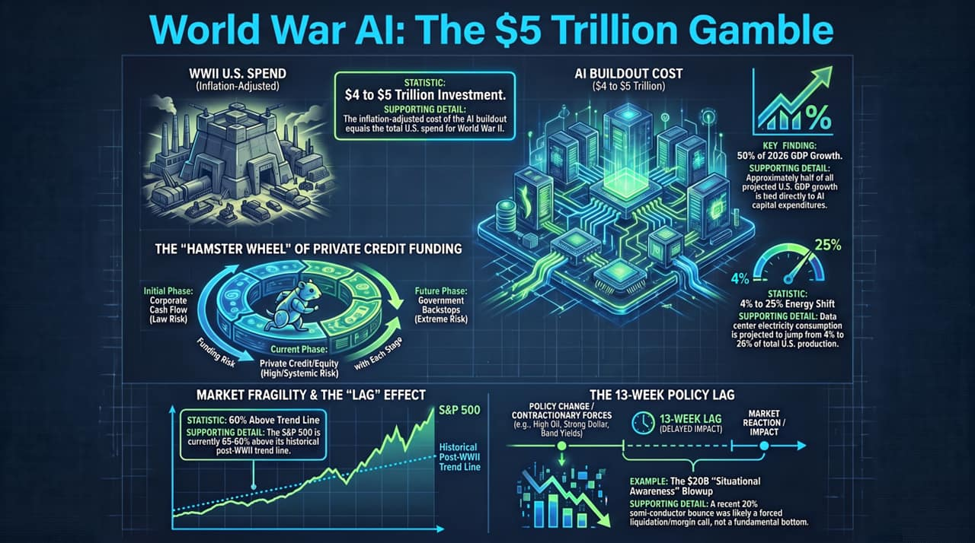
Notes:
Final Diagnostic Wrap-Up:
$4–5 Trillion AI Spend: Equivalent to total U.S. World War II spending.
50% of 2026 GDP Growth: U.S. economic growth is dependent on AI capex.
Private Credit Risk: Funding has shifted from corporate cash flows to high-risk private credit markets.
4% to 25% Grid Strain: Energy bottlenecks create structural inflationary pressure.
13-Week Lag: The market's recent 20% semiconductor bounce reflects a forced margin call resolution rather than a fundamental bottom, right as policy lags begin to weigh on broad activity.

